Slide 1
Sports Betting
Lingo and Profitable Techniques

Slide 2
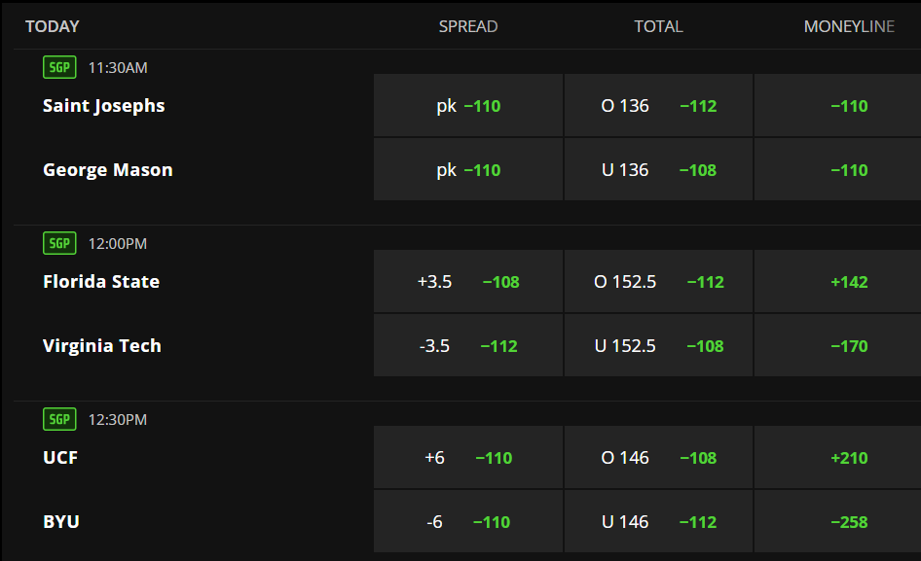
Odds
American
Example from
DraftKings

Slide 3
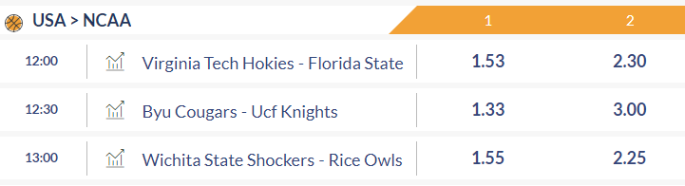
Odds
European/
Decimal
Example from Eurobet

Slide 4
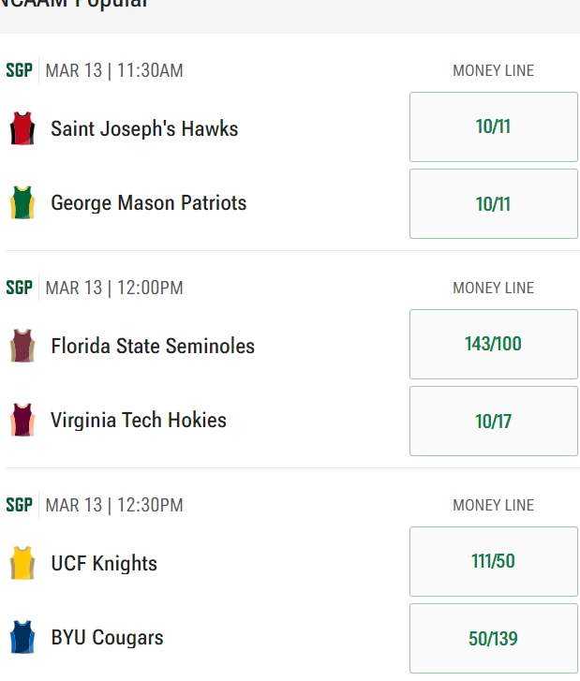
Odds
Fractional
Example from Caesars

Slide 5
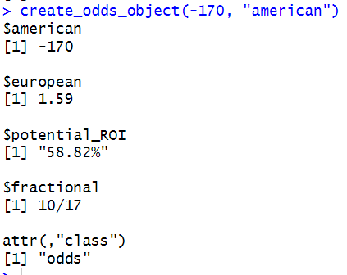
Conversion from american odds - DraftKing example

Slide 6
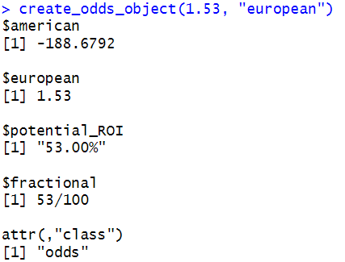
Conversion from european odds - Eurobet example

Slide 7
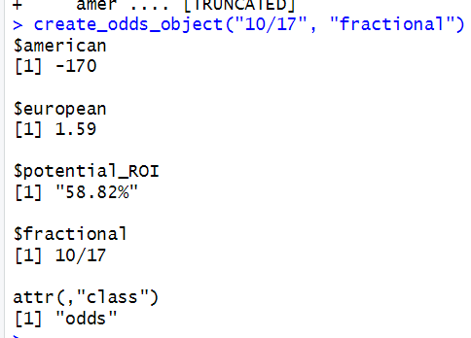
Conversion from fractional odds - Caesars example

Slide 8
Where would you bet on Virginia Tech?

Slide 9
Implied Probability
Implied Probability
Vigorish: “bookmaker’s commission”
Vig Correction: Adjusting implied probabilities to remove vig, ensuring they sum to 1.

Slide 10
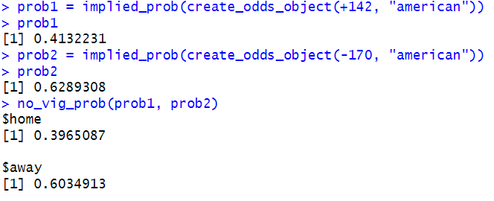
 | Implied Probability | Vig-Corrected Probability
Florida State | 0.413 | 0.397
Virginia Tech | 0.629 | 0.603

Slide 11
Arbitrage Betting

Slide 12
The Idea
Look up odds from different bookmakers and identify best odds for each team
Bet on both teams to win, on different platforms
Obtain guaranteed money

Slide 13
The Idea
Look up odds from different bookmakers and identify best odds for each team
Bet on both teams to win, on different platforms
Obtain guaranteed money
DISCLAIMER:
Only works if odds are sufficiently different across bookmarkers

Slide 14
Algorithm
Find risk-neutral bet proportion p*
Find payout under p*
Bet if payout>0

Slide 15
Testing
Data: Historical Odds and Results for NBA games (N= 29,812)
Arbitrage opportunities in 9.39% of games!!
Mean ROI on those games: 2.85%

Slide 16
EV Betting

Slide 17
The Idea
Look up odds from different bookmakers
Calculate probabilities from odds, assume that those are observations from “true” probabilities of outcome
Infer parameters for “true” probability distribution
Find the betting split/proportion that maximizes the expected payout under the “true” probability distribution
Bet if the maximized expected payout > 0 (or greater than positive threshold to be “safer”)
Make money in the long-run (assuming assumptions are relatively close to being correct)

Slide 18
Future Development

Slide 19
Web Scraping Infrastructure
EV Betting Implementation

